Slide 1

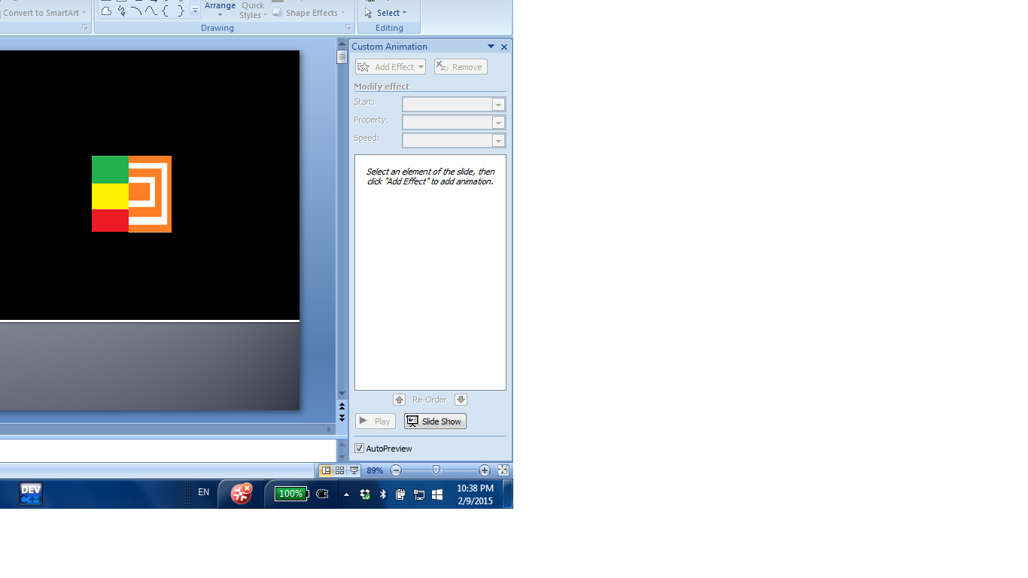
sCORE!
sCORE!
Pitching --- Bryan, Jianzhi

Slide 2
First, let’s look at some examples
Pitching in progress…

Slide 3
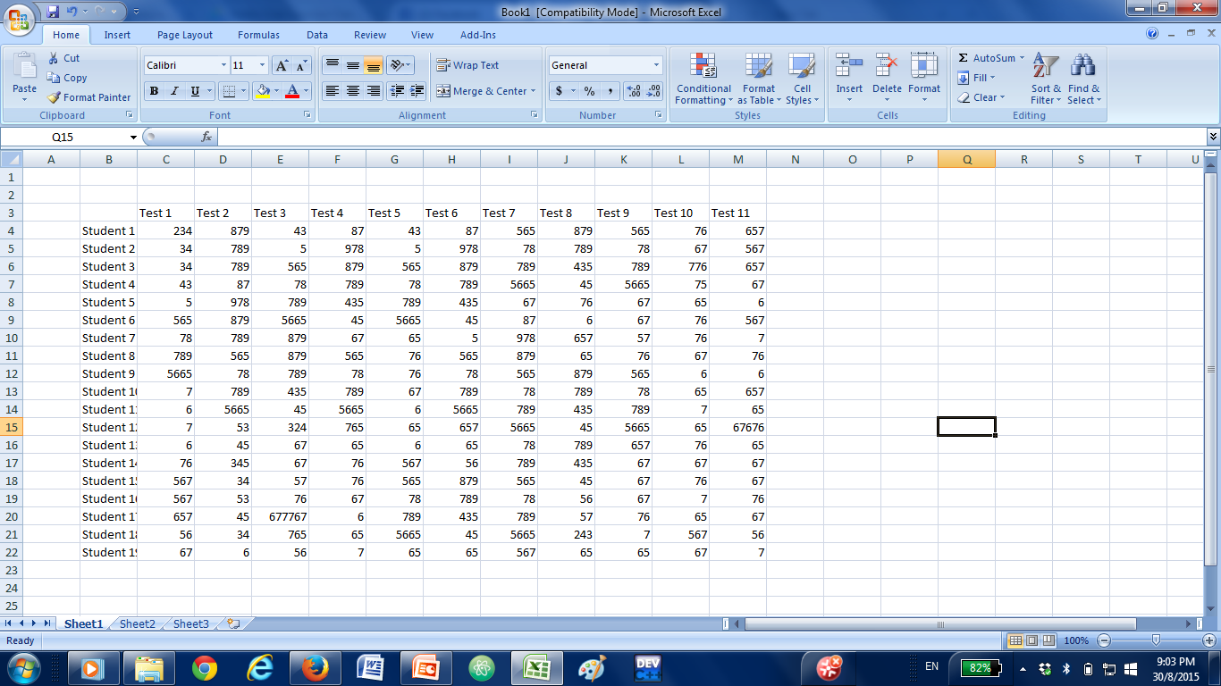
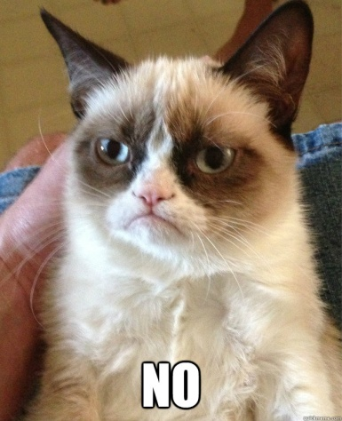
Excel

Slide 4
Analysis of Excel
Advantages:
can sort it according to numerical values
can sort in complicated formula
easy to organise

Slide 5
Analysis of Excel
Disadvantages:
it is boring to look at (the numbers burn my eyes)
not online for everyone to see
cannot switch sorting methods efficiently
unable to sort by time

Slide 6
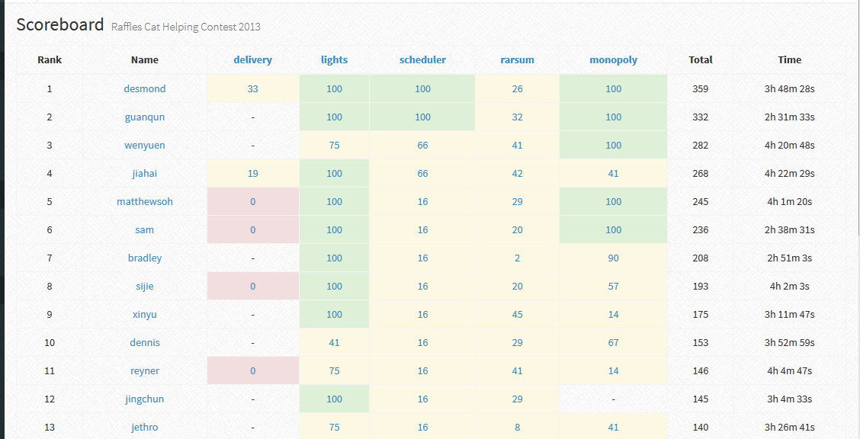
dunjudge

Slide 7
Analysis of dunjudge
Advantages:
it looks better than excel a lot
able to sort by time
able to sort based on numerical values

Slide 8
Analysis of dunjudge
Disadvantages:
it is not public
unable to sort by percentage, specific problems and other methods

Slide 9
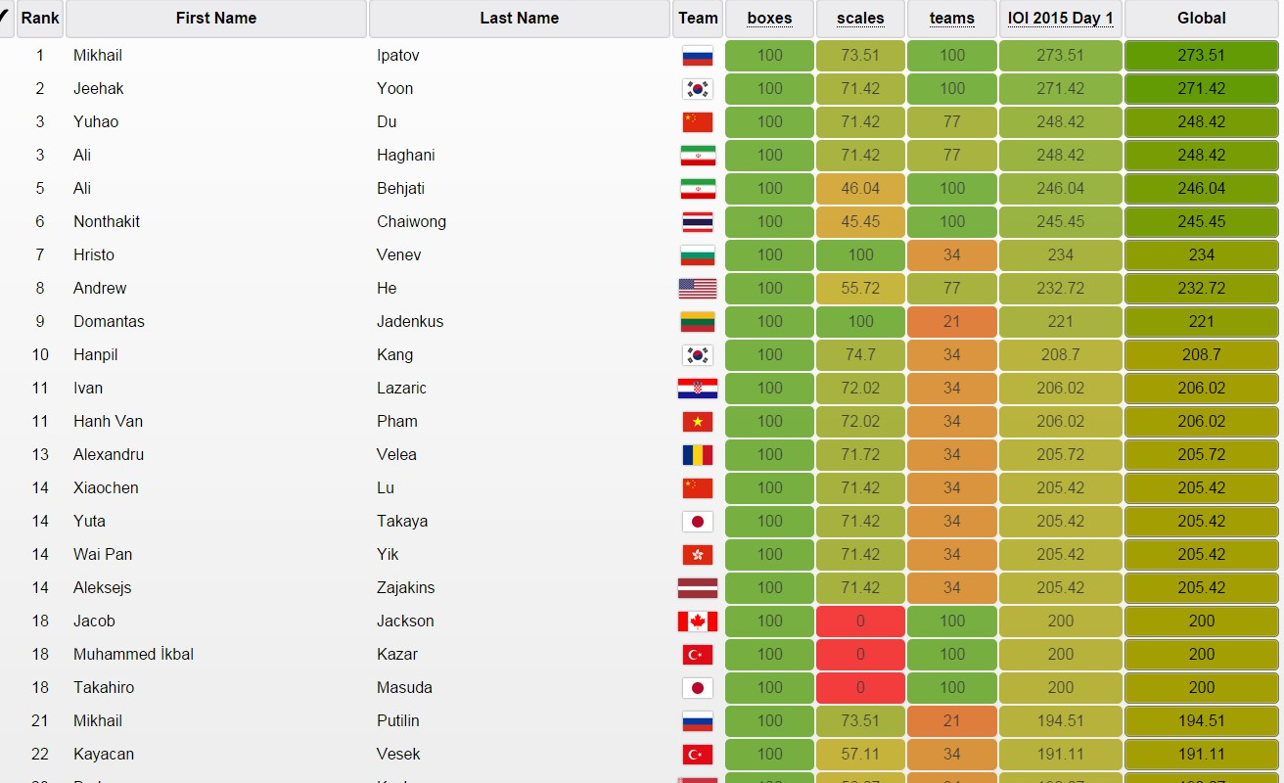
IOI 2015

Slide 10
Analysis of IOI scoreboard
Advantages:
it looks better than excel a lot
has the change in colour tone
able to sort based on numerical values

Slide 11
Analysis of IOI scoreboard
Disadvantages:
unable to sort by percentage and other methods
not public

Slide 12
THE Problem
Boom!

Slide 13
The Problem
Many “scoreboards” are lacking several features
cannot sort (easily) according to percentage or other factors
does not have very nice interface (it looks dull)
are not public

Slide 14
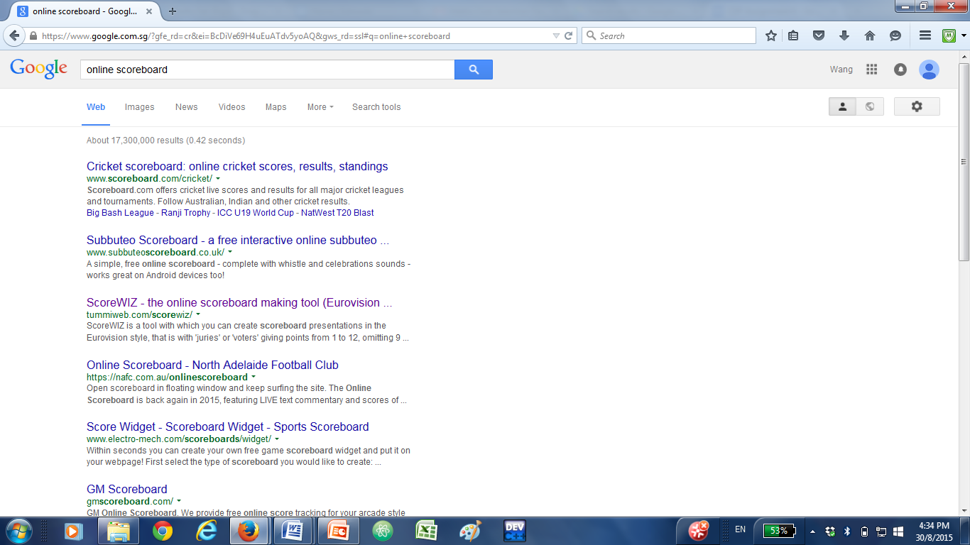
Search

Slide 15
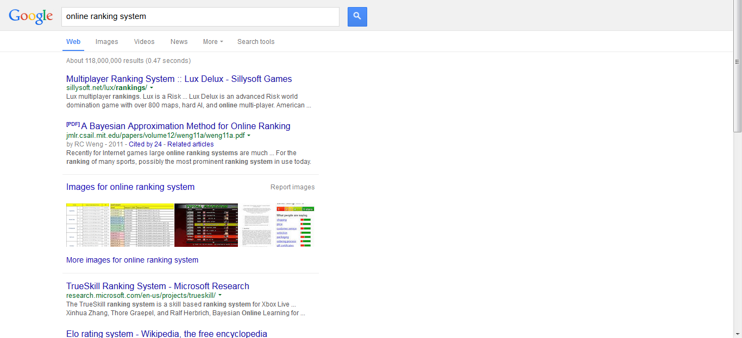
Search again

Slide 16
Implications
There are few (if not no) scoreboards which are public.
We feel that the world needs to have a better scoreboard/ranking system to encourage competitiveness (in any area).

Slide 17
Solution
guess what
THE ULTIMATE

Slide 18


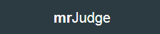
Introducing
sCORE!

Slide 19

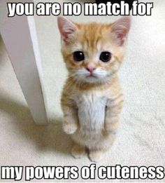
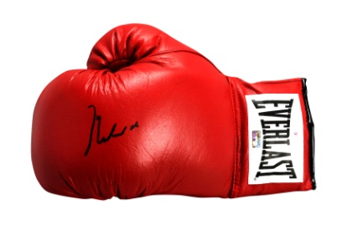
Solution
We plan to make a web application which will majorise Excel and all other scoreboards provided online.

Slide 20
Logo
sCORE!
logo is designed by ourselves which shows our passion for the project
LHS shows green, yellow, red which shows indicators of results
RHS shows a partial scoreboard

Slide 21
Logo
sCORE!
combination of LHS and RHS shows the combination of fun and interest with the seriousness of the scores
dart shows our goals for the project

Slide 22
Logo
sCORE!
exclamation mark shows enthusiasm
CORE is uppercased to emphasise the hardcore-ness of the project
dart shows our goals
Disclaimer: it has nothing to do with England

Slide 23
Objectives
Our product will achieve the following:
nice interface for users
online (for everyone)
able to sort by percentage and other methods

Slide 24
Featuring: FEATURES

Slide 25
Features: Sort
Able to sort by:
time
total score
score for each problem
weighted average
ranging
closest number
specific queries
polynomial p(x)
list is non-exhaustive

Slide 26
Features: Design
The design will be built on the foundation of the idea of the IOI scoreboard --- red, orange, yellow, green tones
We may also include more ideas on the front end

Slide 27
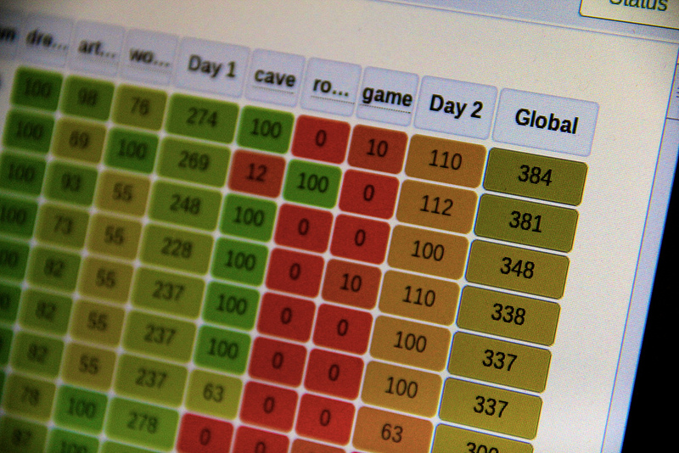
IOI Scoreboard again
We feel that the colour tone places a significant impact on the contestants’ mindsets

Slide 28
Behind the scenes
Registered users can add names to his/her scoreboard --- extremely useful if contestants are repeated
They can create question columns and type in the mark that the named person got for it
They can sort the questions easily by a button on top

Slide 29
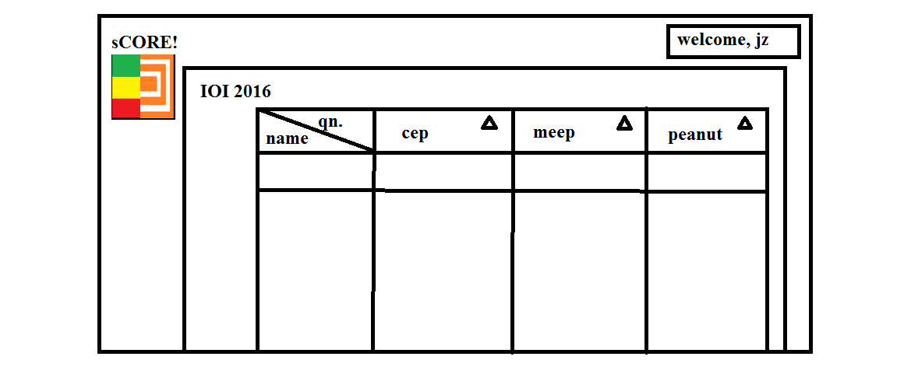
Rough Drawing
peanut
100
100
100
*Diagram not drawn to scale

Slide 30
Why you should be excited?
Mrs. Neo can use our web application for future pitching grading.
She can check for:
total score
the team with the best presentation
mark base on special percentages
total score = 20% presentation + 80% application idea + constant (out of 100)
total score = 0% presentation + 0% application idea + 100 (out of 100)

Slide 31
Why you should be excited?
You or your teachers can now organise in-class contest freely :)
You can set daily scoring system for yourself

Slide 32
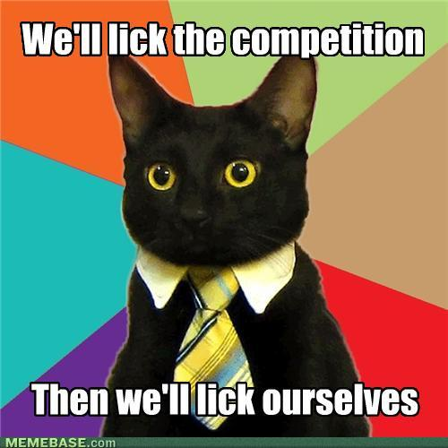
What do we hope to achieve?
promote competitive spirit inside young souls
make tests, exams more interesting
beat excel

Slide 33
Why should you choose US?
Our team is:
creative
passionate
competitive ^^
And
Most Importantly…

Slide 34
Comparison against others
Product | Attractive | Public | Sorting
Excel | No | Yes | Most
dunjudge | Yes | No | Partial
IOI | Yes | No | Partial
sCORE! | Yes | Yes | Most

Slide 35
Thank you!
Pitching over ☺

Slide 36
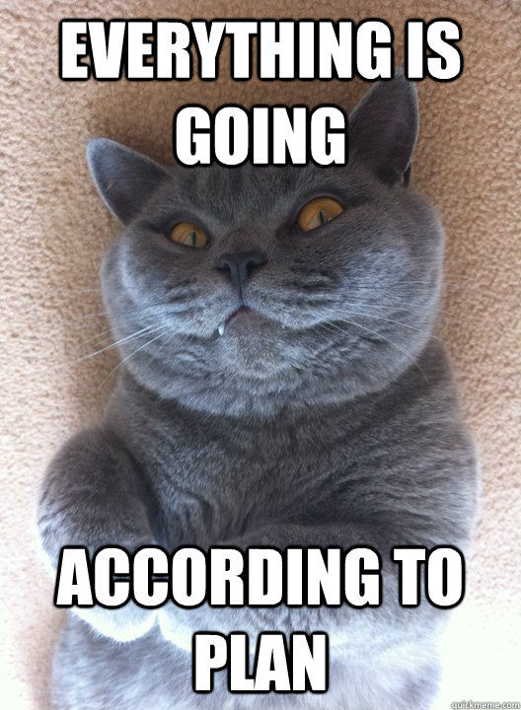
Hahahahahaha

